Slide 1
Final Year Project Progress Presentation 2
James Jamieson

Slide 2
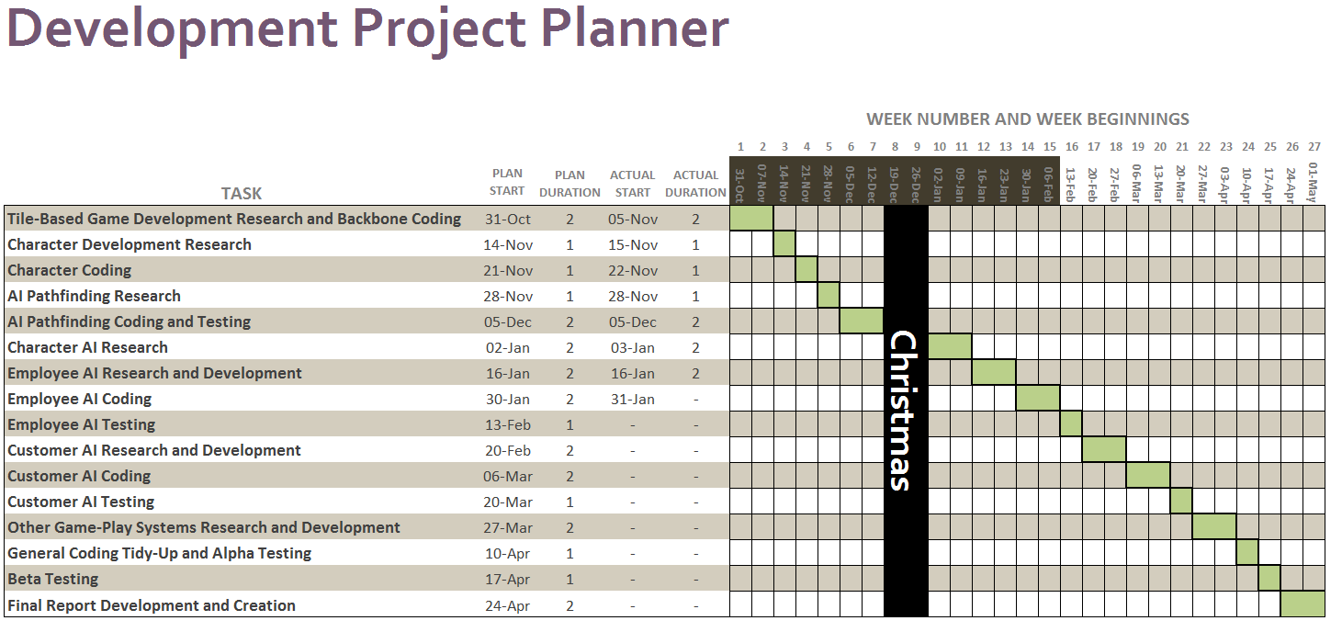

Slide 3
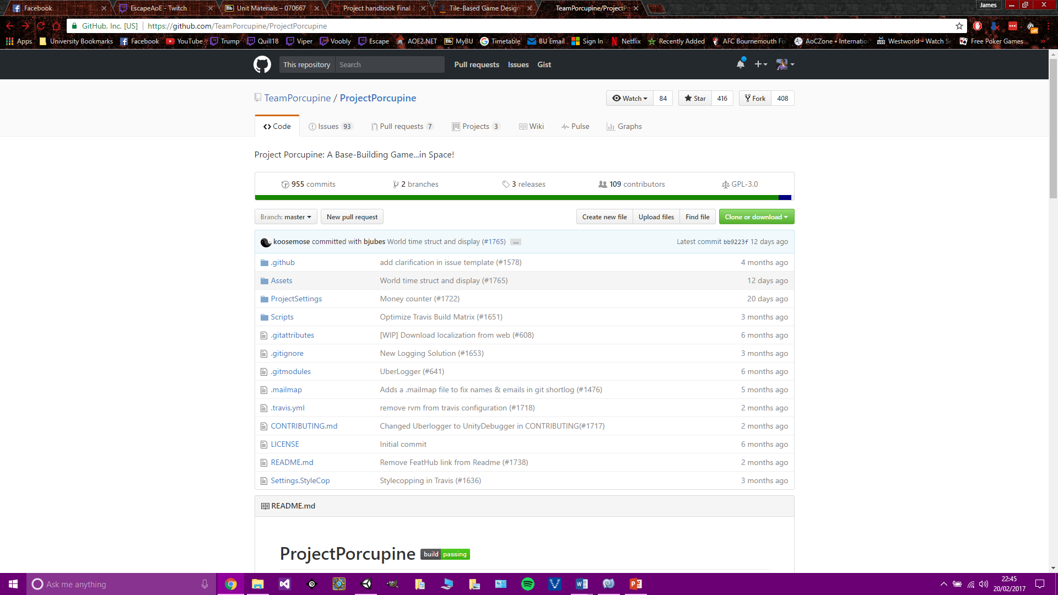
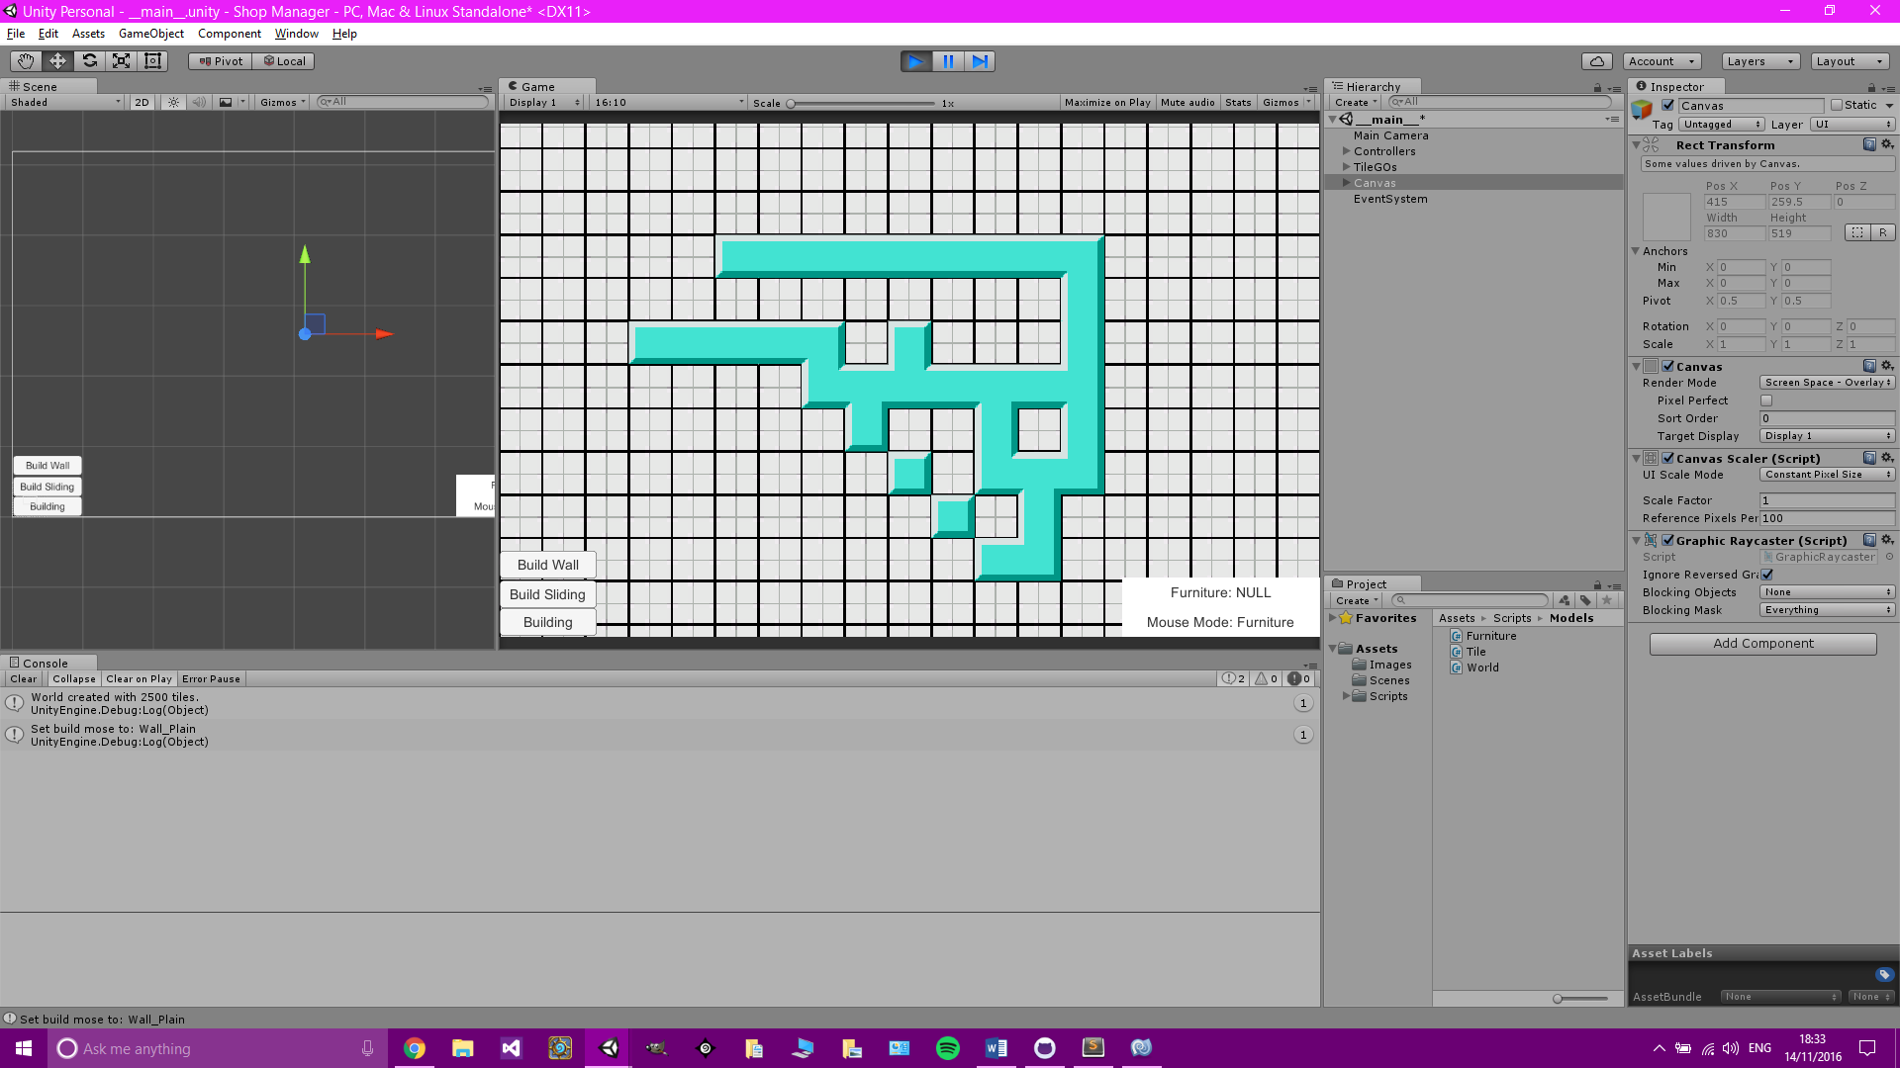
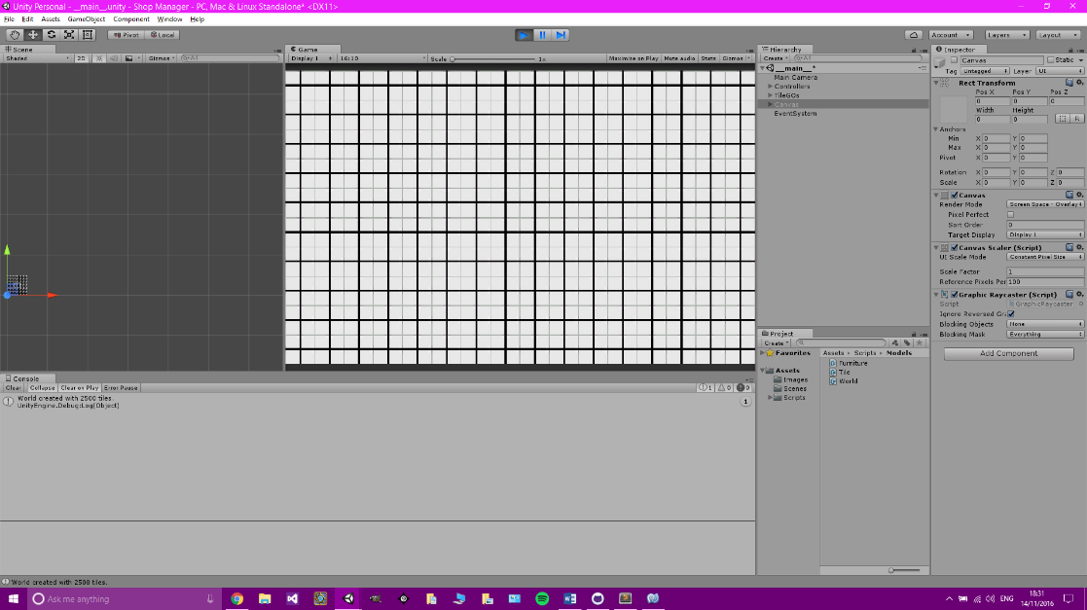
Tile-Based Game Development Research and Backbone Coding
Began initial research on tile-based game development using papers and a project on GitHub based on 2D tile-based game design in Unity.
Created my Unity3D program and added various classes to begin the initial coding.
Created Scripts:
World Controller – Inherits from Monobehaviour
Mouse Controller – Inherits from Monobehaviour
Furniture Sprite Controller – Inherits from Monobehaviour
World
Tile
Furniture
Furniture Actions

Slide 4
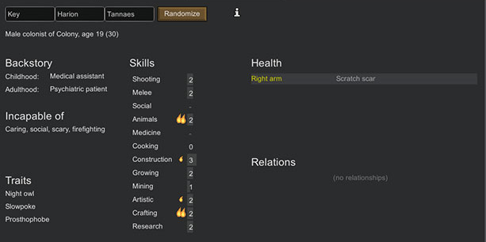
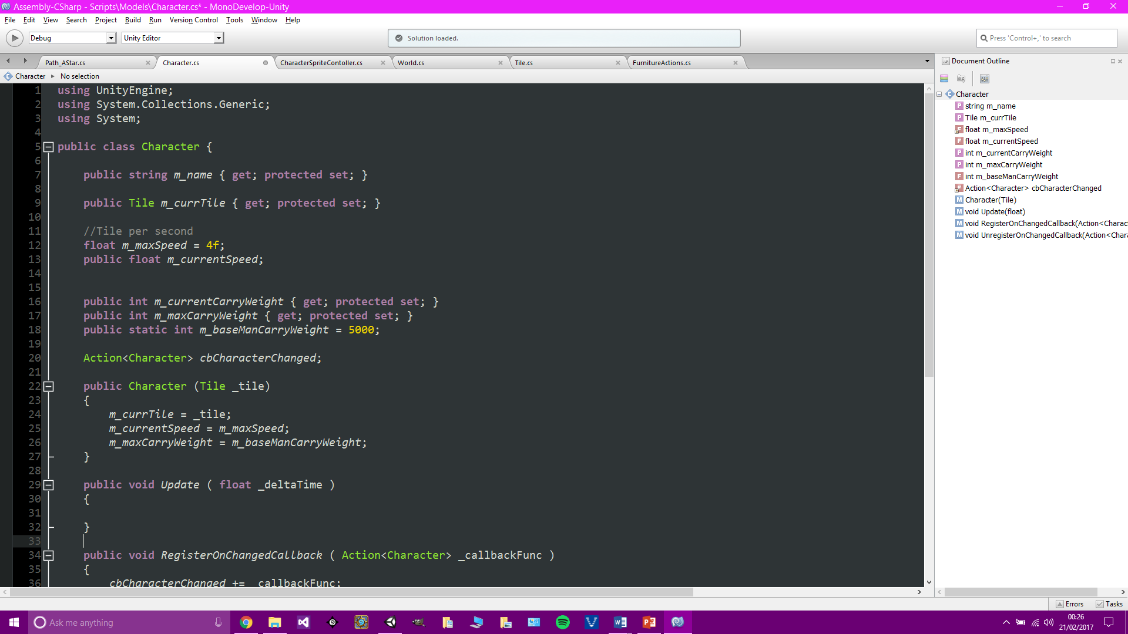
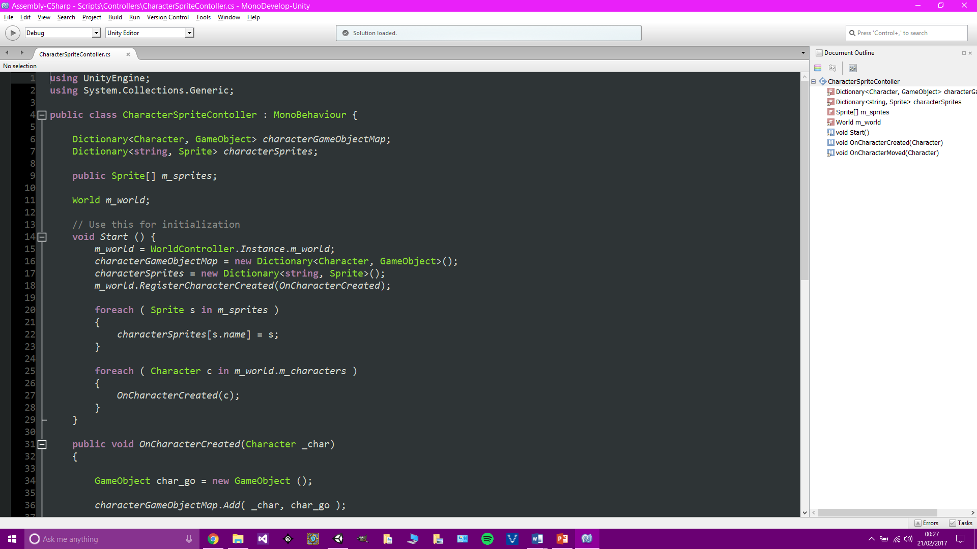
Character Development Research and Character Coding
Research was conducted by looking at popular games with advanced AI.
RimWorld was the main focus with research being done on the skills, backstories, traits, moods and thoughts.
Coding began by creating and developing two more scripts:
Character
Character Sprite Controller
The character class is used as a template for all characters in the game. The Character Sprite Controller links the logic with the GameObjects.

Slide 5
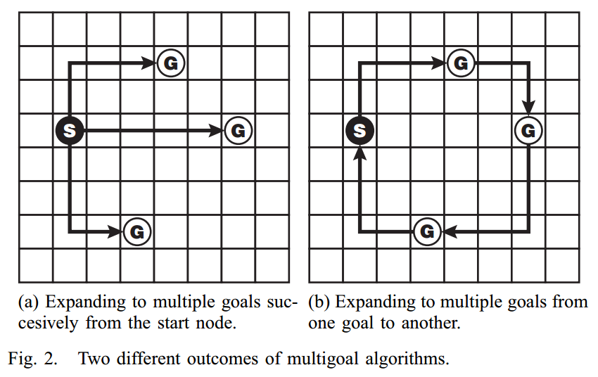
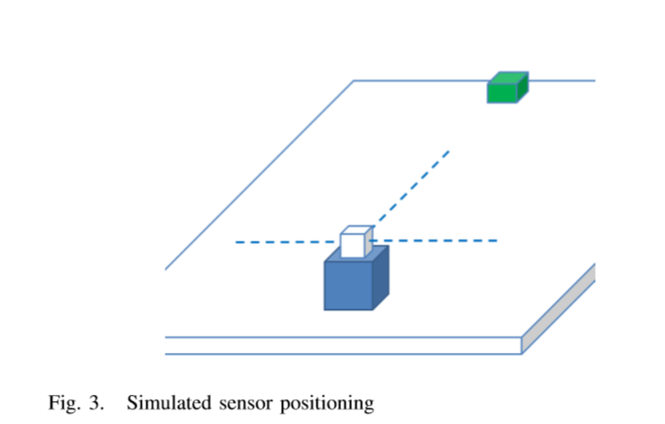
AI Pathfinding Research
Pathfinding is an important part of making AI look realistic.
Papers used for research:
Hybrid Pathfinding
Direction Based Heuristic Pathfinding
Multigoal Pathfinding
Pathfinding for Partially Explored Game Environments.
The hybrid pathfinding paper looked at development of a system that uses both long-distance pathfinding and short-distance enemy avoidance.
The direction based heuristic pathfinding paper explained A* pathfinding and general heuristic advantages and disadvantages.
The multigoal pathfinding paper looked at the advantages and disadvantages of knowing that a character needs to go to multiple goals before any movement is done.
The partially explored game environment paper talked about a learning AI that plans out its path based on what it knows about the environment, and will learn and change its path as it moves and learns about new obstacles.

Slide 6
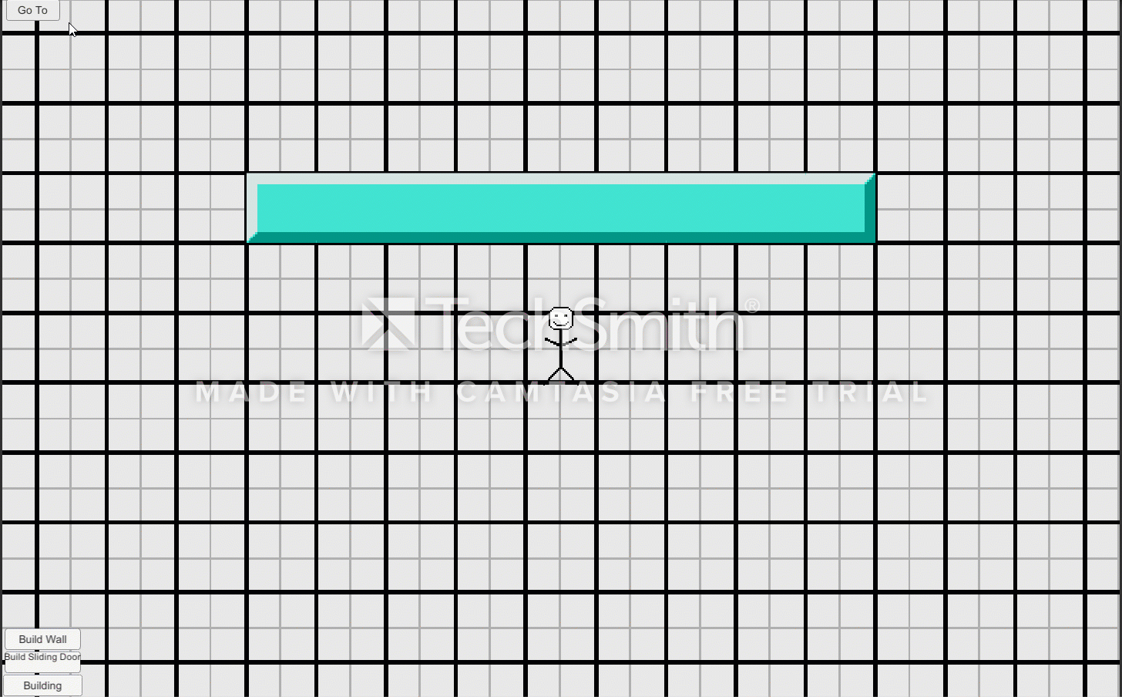
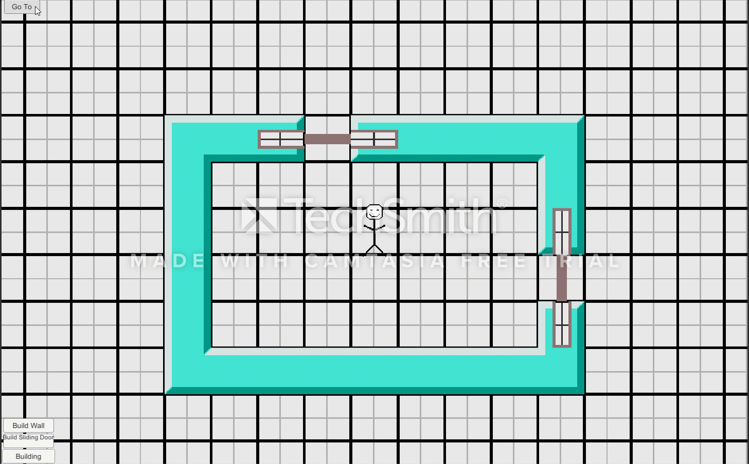
AI Pathfinding Coding and Testing
Node and Edge template classes created. A Tile Graph uses these to create a map of the world.
The algorithm then uses the Tile Graph to create a path from a given tile to a given tile.
Every piece of furniture is given a movement cost, the algorithm will use this stat to move around furniture if it is quicker.
The character uses the route by asking for the next tile they need, then they work out if the next tile can be entered. If a door is in the tile, the character waits and alerts the door that it needs to open. Once it is open, the character carries on through the tile. The character will also slow its movement if the tile’s movement speed is above 1 because it has furniture on it.
A button was added to the Unity project in order to test the pathfinding. Once the button is pressed, clicking on a tile will move the character to that tile.
Pathfinding Example - Wall
Pathfinding Example - Door

Slide 7
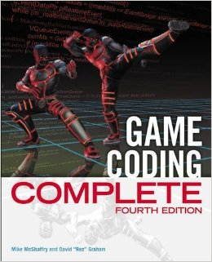
Character AI Research and Employee AI research and Development
5 papers were found during the research to help with the project.
Emotion-Based Synthetic Characters – How dynamic emotions based upon the environment and other characters can create a very realistic AI.
Human-like NPCs using pheromone maps. Characters learn about their environment by storing a map of their surroundings and using it to adjust their decisions.
Adaptive behaviour control models. In-depth look at fuzzy logic and its advantages and disadvantages.
Component based hierarchical state machines. Advantages and disadvantages of advanced and large-scale finite state machines in a component based form.
Game coding complete. Lots of great information about AI techniques. It explained in detail:
Finite State Machines
Decision Trees
Fuzzy Logic
The two final topics are not currently used, but will be once thoughts and moods are added to the AI system.

Slide 8
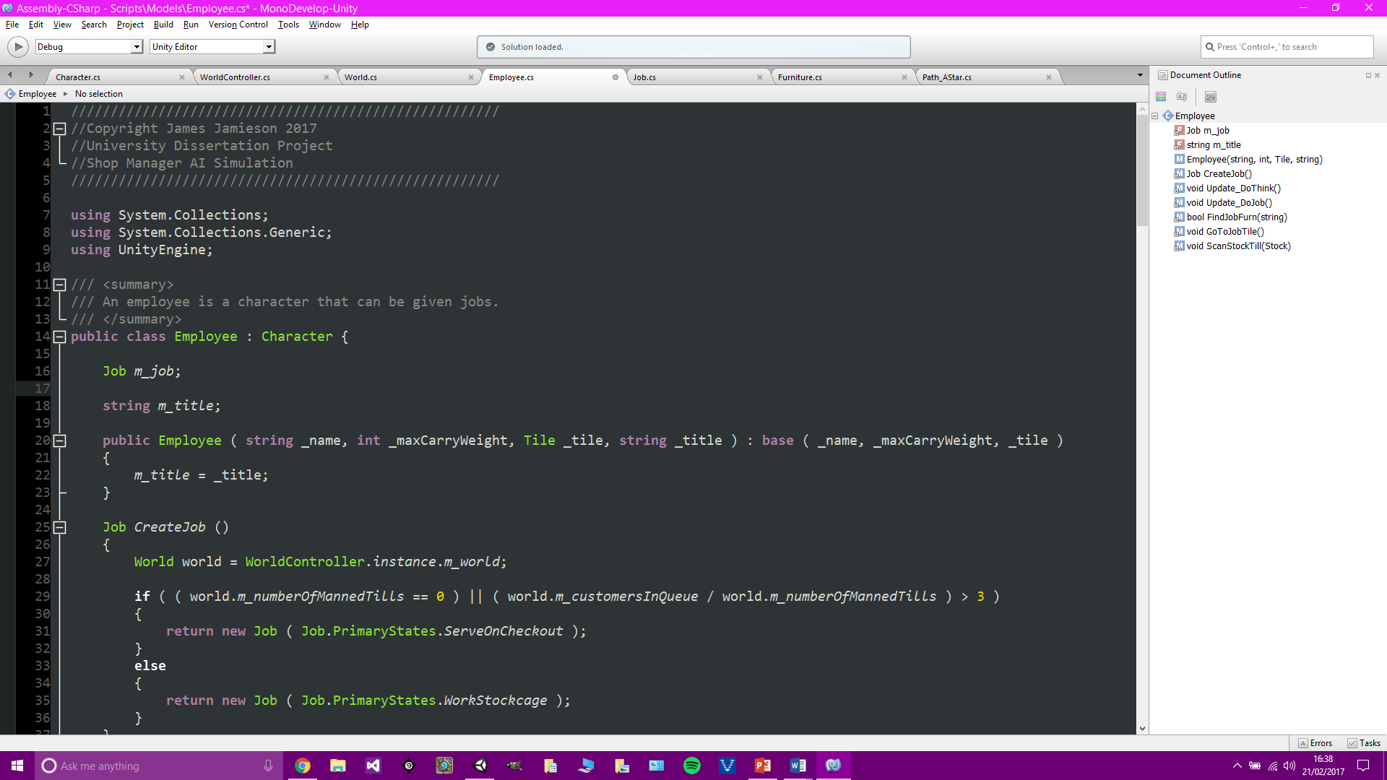
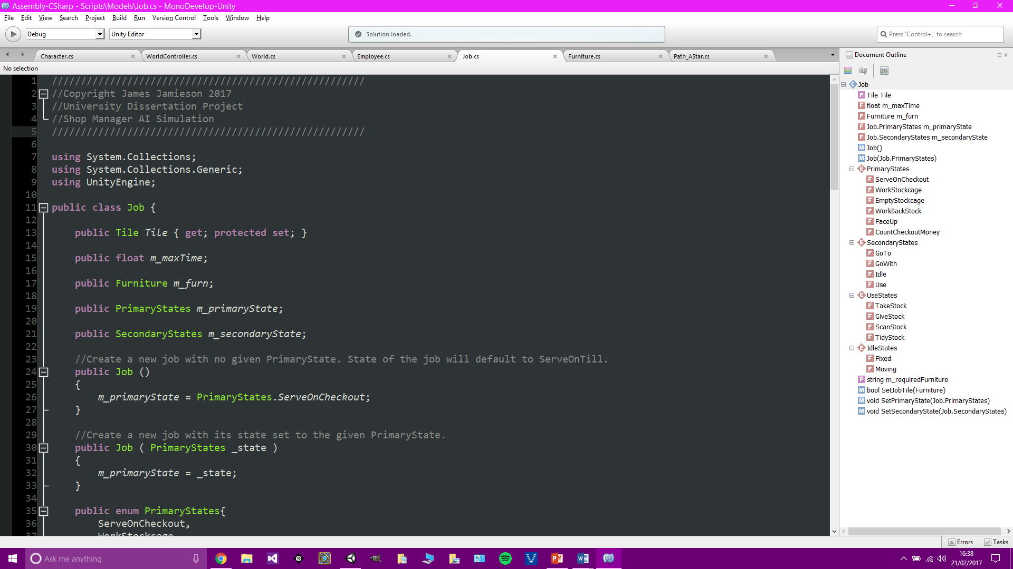
Employee AI coding - 1
New classes created: Job and Employee.
The Character class is changed to be abstract and employee inherits from character.
The Job class keeps the states needed for the finite state machine and other job specific data.
Primary States:
Serve On Checkout
Work Stockcage
Empty Stockcage
Face Up
Count Checkout Money
Primary states represent entire jobs.
Secondary states represent individual tasks within each primary state.
All characters have an Update_DoThink() function which is overridden for the employee class, and in the future the customer class.
Employees’ DoThink function contains the job finite state machine.
Employees also have an Update_DoJob() function which is run when the employee needs to perform a task with a piece of furniture for a job.
Secondary States:
Go To
Go With
Idle
Use

Slide 9
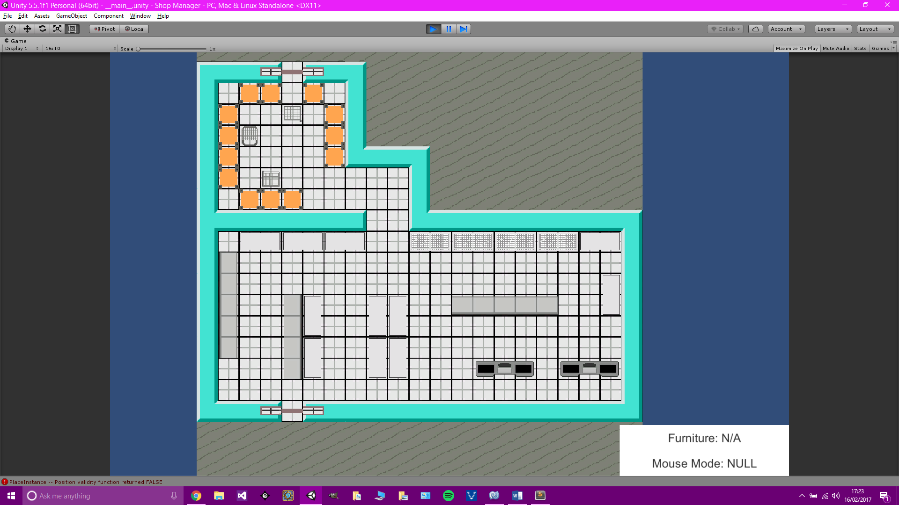
Employee AI coding - 2
Initial thoughts were then made on the beta testing. Specifics were hard to think about but the general testing areas are:
Job priority decisions
Communication
Traits, Thoughts and Moods
Line-Of-Sight if implemented.
Testers should not pay attention to game balancing, graphics or sound.
After looking at testing, focus was brought back to the AI.
Stock was added into the game. All furniture and characters can carry stock, as long as its max weight limit is not exceeded.
Functions for taking and giving stock were added to furniture and characters.
The employee checkout logic was tested and found that it would repeat scanning the same items, and so a flag was given to stock for sold items, and this is used when employees are scanning items.
Selection UI was then added to the Unity project to allow easier debugging as stock can be seen on individual furniture.
To the right is the layout of the shop, and this will be used from now on for testing.

Slide 10
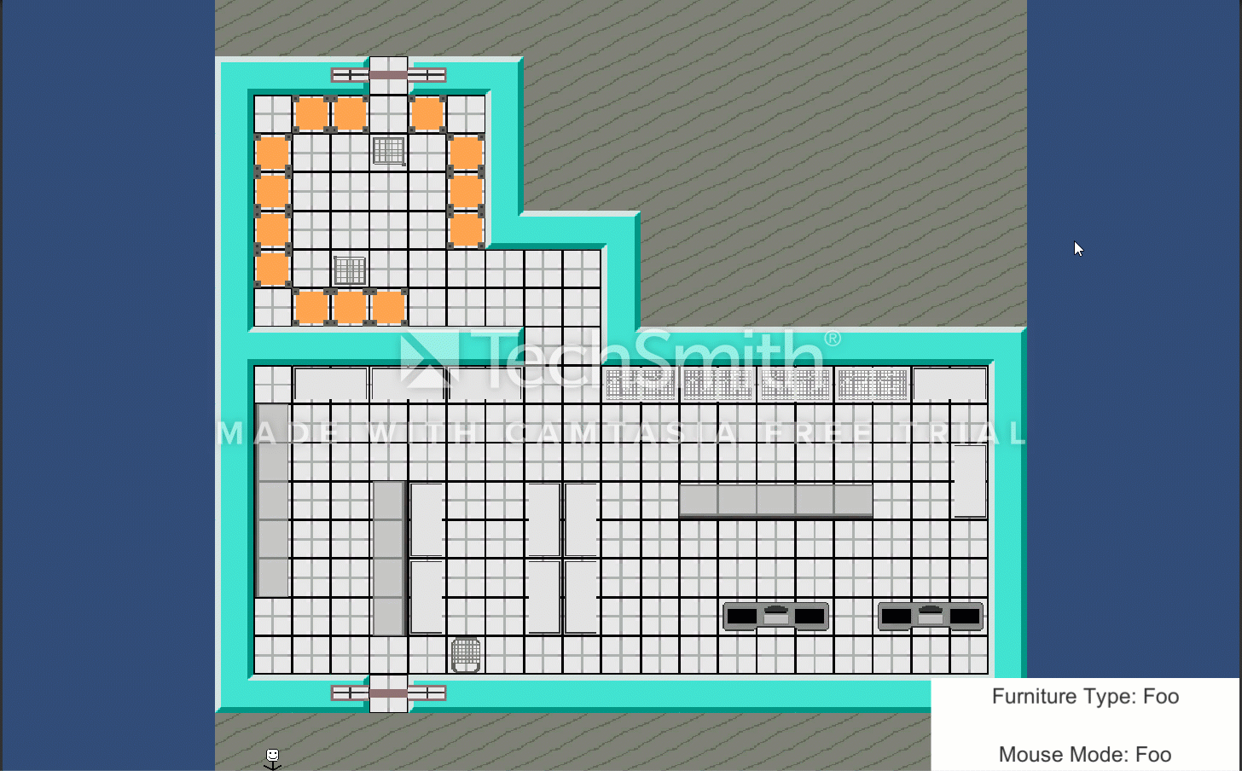
Employee AI coding - 3
Movable furniture was then implemented. Trolley and stock cages are the only furniture that can be moved.
This was a challenge as the base furniture logic had to be changed due to furniture not always being in one tile for the duration of the game.
The furniture actions class is used to implement a moving system similar to the character movement function. However, a character is needed to alter the furniture’s destination, which is realistic and is a successful implementation of the required level of furniture AI.
Next I added a system which allows characters to move movable furniture out of their way if it is blocking their path; it began with the character simply pushing the furniture along until it was no longer in the way, but this looked unrealistic and simple and so had to change.

Slide 11
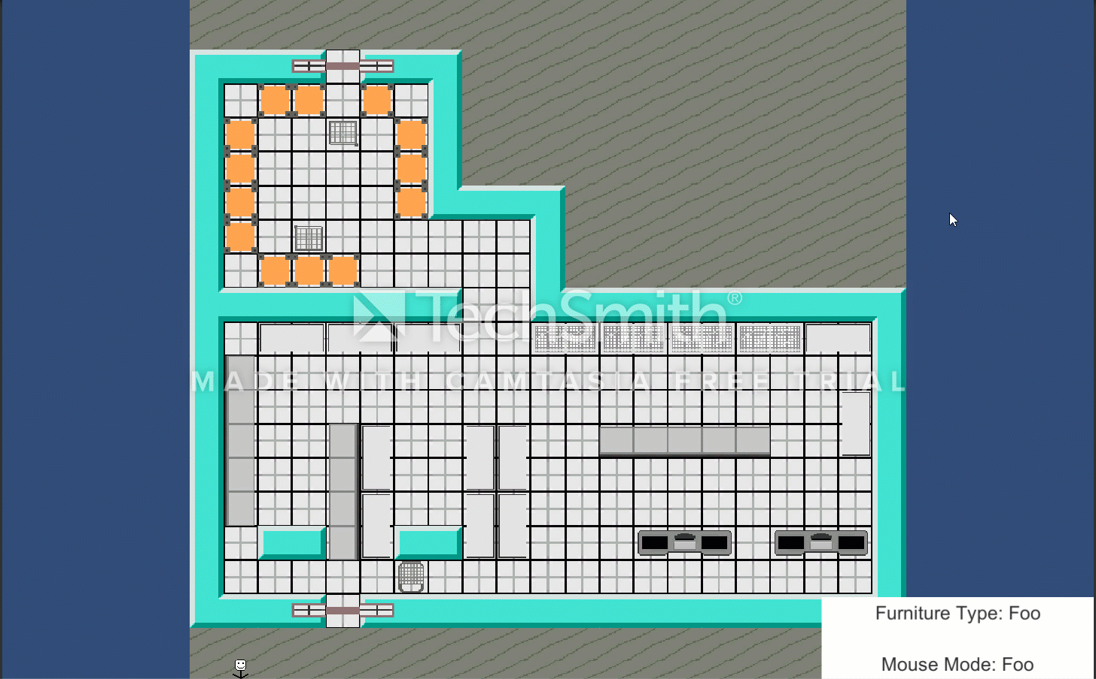

Employee AI coding - 4
Now a floodfill is created and finds the nearest free tile, that isn’t in the character’s final path. This created a much more realistic way for the character to decide where to put the furniture.
Another problem was found however, even though the furniture is no longer on the path from the initial origin of the character to its destination, it could now be in the way of the character new path to the destination. The character will once again floodfill and move the furniture, but it was found that eventually the character could block themselves into a corner as the nearest tile kept being directly behind them. A solution needed to be found.
Now when a free tile is found, the character will call a recursive function which simulates where they and the furniture WILL be and works out if the furniture will still be in the way. This will again recursively simulate the new location, and will do with again and again until either, the character gets trapped, or the furniture ends up on a tile that isn’t required for the character to get to their final destination. If the character will get trapped, the initial tile is marked as invalid.
Before Recursion Implementation
After Recursion Implementation

Slide 12
Before Recursion Implementation

Slide 13
After Recursion Implementation

Slide 14
Near Future Work
Due date for employee AI code – 20th February – Not completed
Stock and movable furniture code took longer than anticipated.
Rest of the AI code should be simpler with the improved and more advanced recursive movable furniture code.
Within a week, the employee AI is to be completed.
Interaction between characters will be completed within the customers AI phrase.
Customer AI phrase will take less time than planned due to the abstract character class allowing common code between employees and customers.

Slide 15



Review of Aims
The A.I. system should include the following:
Pathfinding – Most likely version will be the A* algorithm but others will be researched and the best will be chosen.
Job decisions – The employees will need to decide which job is next on the list, based upon job priorities set by the player. Research will be done on games currently using this system, such as RimWorld [3].
Shopping Choices – The customers will need to know what products they are after and then look for them. If they can be found by the customer, then the decision needs to be made on whether to actually buy the item based upon the item’s quality and price.
All of these features will be fully testing using alpha and beta methods.

Slide 16
Questions?

